Slide 1
Eye for Blind
Ankit Chand
DDS2020080

Slide 2
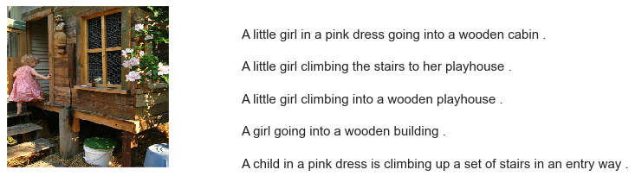
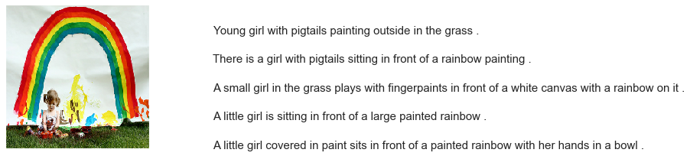
Problem Statement
The idea is to build a product that can explain the contents of an image in the form of speech through caption generation. This model is a use case for blind people and can help them understand any image with the help of speech.

Slide 3
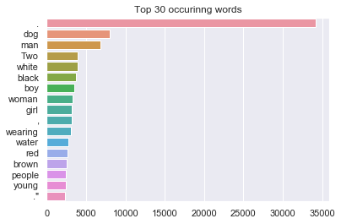
Workflow
Data size: consists of a sentence-based image description having a list of 8,000 images that are each paired with five different captions, which provide clear descriptions of the salient entities and events of the image.

Slide 4
CNN-RNN based Attention model:
Convert contents of an image into text and then further convert text into speech output
Trained the model using Adam Optimizer and categorical cross entropy loss function for 15 epochs.
Finally, predicted the test data and its percentage belonging ta a particular category.
Image
Encoder
(CNN)
Decoder
(RNN)
Caption
Speech

Slide 5
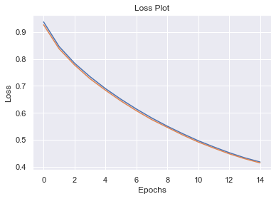

Slide 6
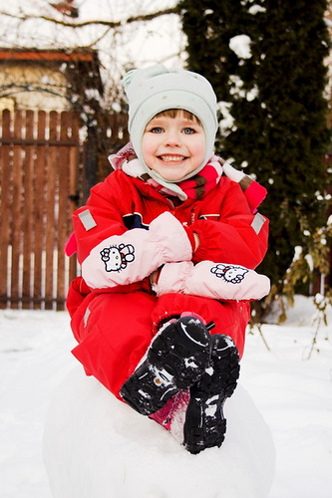
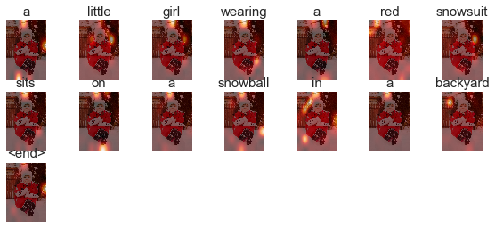
BELU score: 88.64 Real Caption: a little girl in a red snowsuit sits on a snowball in a backyard Prediction Caption: a little girl wearing a red snowsuit sits on a snowball in a backyard

Slide 7
Thank You

